Slide 1
Conclusions
Approval Factors:
Income
Age
Education
Notes:
Hello, Today I’ll be presenting Conclusions & Recommendations.
In conclusion, we found there were three key factors for approval such as
Income, Age and Education

Slide 2
Income
- Minimum income:
$27,000
- Maximum income:
$1,575,000
Minimum income accepted based on family size:
Count of family member | Minimum accepted income
1 | $36,000
2 | $27,000
3 | $33,300
4 | $45,000
5 | $37,800
6 | $67,500
7 | $112,500
9 | $157,500
15 | $225,000
20 | $1,125,500
Notes:
Minimum income was $27,000 while the maximum income was just over $1.5 million
As you can see from the following table, the minimum income accepted based on family size was
36,000 for 1 family member
27,000 for 2 family member
33,300 for 3 family member
While a family member count of 20 required a minimum income of $1.1 million.

Slide 3
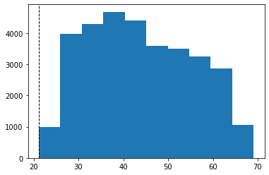
Age
minimum age for approval is 21 years of age.
Note: out of 30 applicants 21 years of age, only 4 were accepted.
Education
Approval ratio for applicants having academic degree was 9.94%
Approval ratio for applicants with other degrees was 7.5%
Notes:
The minimum age for approval was 21 and it is important to mention that out of the 30 applications, 21 years of age, only 4 were accepted.
Education: the Approval ratio for applicants having an academic degree was 9.9% while the approval ratio for applicants with other degrees was 7.5%

Slide 4

Recommendations
Data Related Recommendations
Automating Applications and Approval Process
Notes:
Recommendations were split into 2 categories:
Data Related Recommendations
&
Automating Applications and Approval Process.

Slide 5
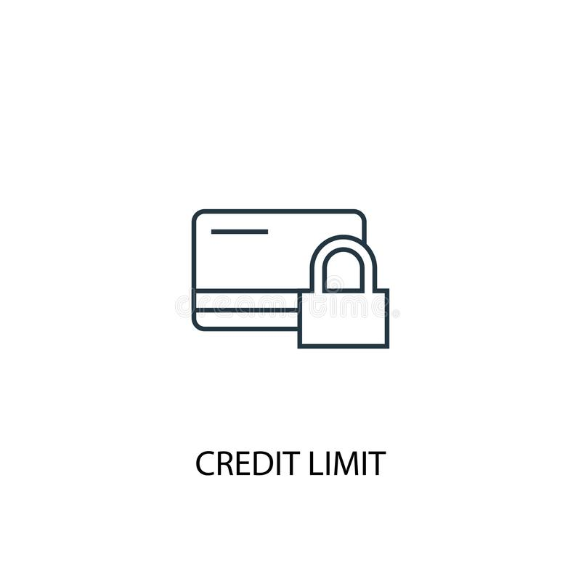

Data Related Recommendations
Updating application information for all account holders
8,983 approved accounts with missing application information
Adding Credit limit Column
Income Total:
What is the appropriate currency? USD? CAD? …?
Is it household total income or applicant income total?
How many people live in the same household?
Notes:
For Data related information we recommend :
Updating application information for all account holders as 8,983 active accounts are missing application information.
Next we recommend Adding a Credit limit Column as well as Properly labeling the Income Total Column to the appropriate currency. Eaither USD or CAD.
And Lastly, we feel it would be beneficial to add another column labeled “count_of_Household_members” as this will allow for an accurate view of how many people live under the same household.

Slide 6

Automating Applications and Approval Process
Pre-approval Criteria
Income Validation
Pre-Approval Credit Limit Bracket
- Credit Limit Increase
Credit Score
Notes:
Our Second Recommendation,
Automating Applications and Approval Process has been split into 4 categories:
pre approval Criteria
Income Validation
Pre Approval Credit Bracket &
Credit Score.

Slide 7


Pre-Approval Criteria
Income Validation
The following requirements must be met to qualify for pre-approval:
declared Income greater than $150,000
must be verified!
Age
Months employed
Gender
Social number (new field)
Mobile number
Email
Notes:
For Pre approval criteria:
The following application fields must be met in order to qualify for pre-approval
Age
Months employed
Gender
Social Security Number as a new field
Mobile number &
Email.
For Income Validation we strongly recommend to verify any income amount grater than $150,000

Slide 8
Pre-Approval Credit Bracket
Income Amount | Income Type | Months Employed | Education Type | Own Car | Own Realty | Credit Limit
27,000 – 50,000 | Pensioner | - | - | - | - | 5,000
20,000 – 50,000 | Students | - | - | - | - | 5,000
50,000 – 100,000 | Working | 12 or more | - | - | - | 10,000
50,000-100,000 | - | 12 or more | Academic degree or Higher education | - | - | 15,000
100,000 – 150,000 | - | 12 or more | - | Yes | Yes | 20,000
More than 150,000 & Verified | - | - | - | - | - | 25,000
Note: Credit limit amounts and bracket requirements are suggestions and should be changed at the bank's discretion.
Notes:
Pre-Approval Credit Bracket.
This Bracket was created to streamline the application approval as this will allow for faster approvals while limiting credit based on each criteria
The braket is as followed:
Bracket 1:
Bracket 2
Bracket 3
Just to give you an idea.
Credit limit amounts and bracket requirements are suggestions and should be changed at the bank's discretion.

Slide 9
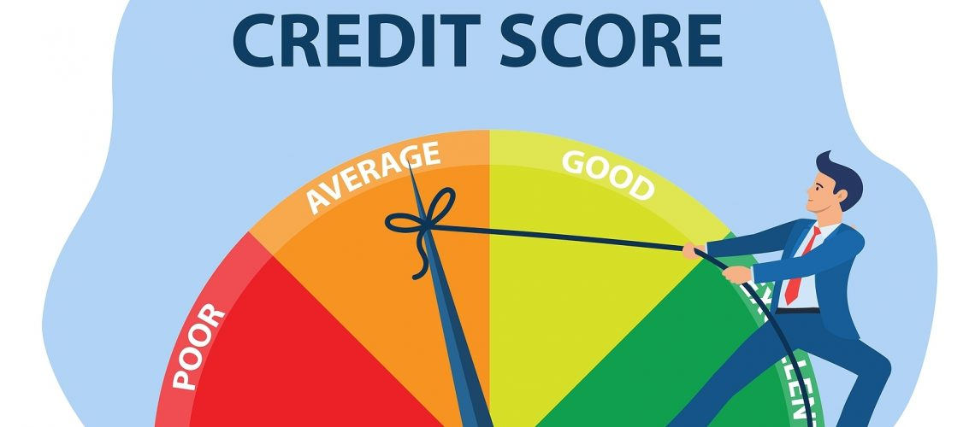
Credit Limit Increase
Credit Score
A system to retrieve the credit score for the applicant from a trusted credit bureau based on their Social Security.
Accounts with "Past Due" statuses of "C" or "1" in the last 6 months can request a credit limit increase.
A "credit score" column should also be created and maintained with the actual credit score or an average of the last 12 months.
Notes:
Next, Credit limit Increase:
Accounts with past due statuses of C or 1 in the last 6 months can request a credit limit increase.
And Lastly, we have Credit Score:
We highly recommend setting up a system which will retrieve the credit score for each applicant from a trusted credit bureau based on the Social security number provided. This means that a credit score column should be created and maintained with the actual credit score or the average of the last 12 months.

Slide 10

Thank you for your
attention!
Notes:
Thank you for your attention.

Slide 11
Resources
Tableau
Google
Datacamp
Pandas
SQL

